Slide 1

MINOR PROJECT-
SOCIAL MIRROR
MENTOR- MR. VARUN GOEL
SUBMITTED BY-
HARSHIT SACHDEV | NIKHIL JAIN | ABHISHEK JAIN
(9917102235) (9917102258) (9917102234)

Slide 2
Table of contents
INTRODUCTION
OBJECTIVE
BLOCK DIAGRAM
APPROACHES
LEXICAN BASED APPROACH
MACHINE LEARNING APPROACH
FLOW OF MACHINE LEARNING APPROACH
GATHER AND UNSTRUCTURED DATA
DATA CLEANING AND PREPROCESSING
VECTORIZED DATA
ALGORITHM SELECTION

Slide 3
CHALLENGES FACED
FUTURE SCOPE
REFRENCES

Slide 4


INTRODUCTION
Social media have emerged as one of the platforms to raise users’ opinions and influence the way any business is commercialized.
Opinion of people matters a lot to analyze how the propagation of information impacts the lives in a large-scale network like Twitter.
Sentiment analysis of the tweets determine the polarity and inclination of vast population towards specific topic, item or entity.

Slide 5
OBJECTIVE
To study the sentiment analysis in microblogging which in view to analyze feedback from a customer of an organization's product
and
To develop a program for customers' review on a product which allows an organization or individual to sentiment and analyzes a vast amount of tweets into a
useful format.

Slide 6
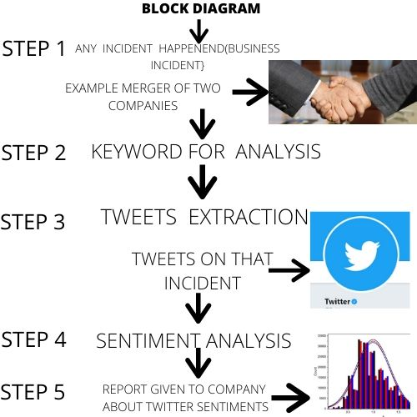

Slide 7
APPROACHES
LEXICON BASED APPROACH
Involves calculating the sentiment from the semantic orientation of word or phrases that occur in a text
Uses predefined list of words where each word is associated with a specific sentiment .
In this approach a dictionary of positive and negative words is required, with a positive or negative sentiment value assigned to each of the words

Slide 8
ADVANTAGES
Does not rely on labelled data
It is easier to generate an appropriate lexicon than collect and label relevant corpus.
it has the ability to adapt and create trained models for specific purposes and contexts.
It can be more easily understood and modified by humans

Slide 9
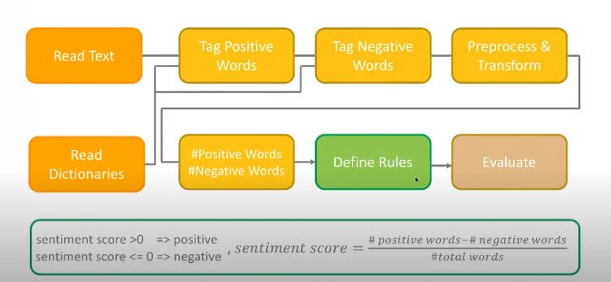
BLOCK DIAGRAM

Slide 10
ALGORITHM
Pre-processes each tweet, post by remove punctuation
Initialize a total polarity score (s) equal 0 -> s=0
Check if token is present in a dictionary, then
If token is positive, s will be positive (+)
If token is negative, s will be negative (-)
Look at the total polarity score of tweet post
If s > threshold, tweet post as positive
If s < threshold, tweet post as negative

Slide 11
2. MACHINE LEARNING APPROACH
Rely on supervised classification based approach
In this sentiment detection is framed
as a binary which are positive and negative
This approach requires labeled data to train classifiers
It becomes apparent that aspects of the local context of a word need to be taken into account such as negative (e.g. Not beautiful) and intensification(e.g. Very Beautiful)

Slide 12
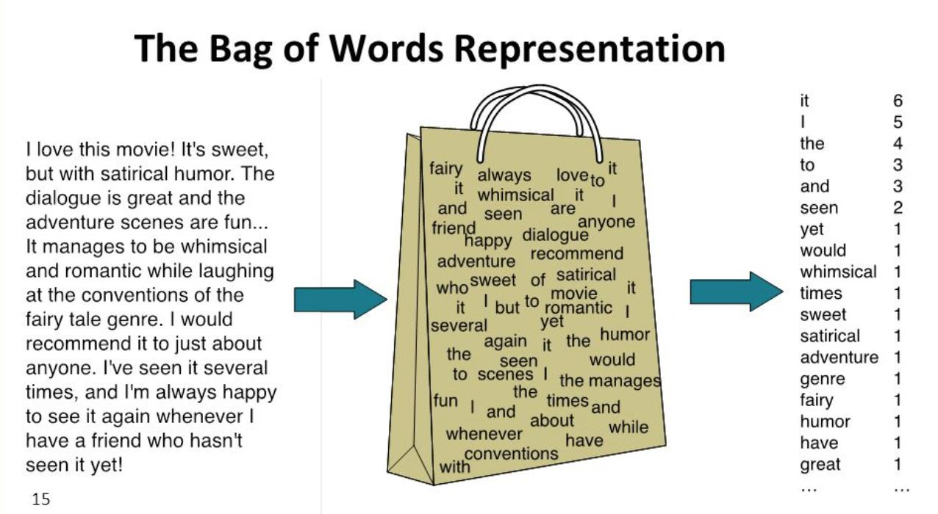

Slide 13
FLOW OF MACHINE LEARNING APPROACH
GATHER UNSATURATED
DATA
DATA CLEANING AND
PREPROCESSING
VECTORIZED DATA
ALGORITHM SELECTION

Slide 14
TRAINING AND VALIDATION
PREDICTION

Slide 15
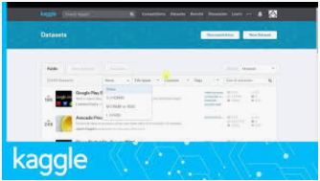
GATHER UNSTRUCTERED DATA
We collect data from large databases like kaggle
Kaggle is an online community of data scientists and machine learners.
From here tweets are collected

Slide 16
DATA CLEANING AND PREPROCESSING
It has following parts
1. STOPWORDS
Removal of unwanted words are done like single letter words (a ,and ,an)etc
2. STEMMING
Process where words are reduced to a root by removing inflection through dropping unnecessary characters, usually a suffix.
3.LEMMATISATION
It is the process of grouping together the inflected forms of
word so they can be analysed as a single item, identified by word's lemma, or dictionary form.

Slide 17
VECTORIZED DATA
It has following parts
2. COUNT VECTORIZER
Provides a simple way to both tokenize a collection of text
documents and builds a vocabulary of known words
Encodes new documents using that vocabulary.
Call the fit() function in order to learn a vocabulary from one or more documents
2. TF IDF
In information retrieval, tf–idf or TFIDF, short for
term frequency

Slide 18
Inverse document frequency, is a numerical statistic that is intended to reflect
how important a word is to a document in a
collection or corpus
3.Word Embedding

Slide 19
ALGORITHM SELECTION
We have used four algorithm techniques
1.RANDOM FOREST
Also called random decision forests
A type of supervised machine learning algorithm based
on ensemble learning
It is one of the most ensemble classifiers
Very fast and robust against over fitting which makes it
possible to form as many trees as user wants

Slide 20
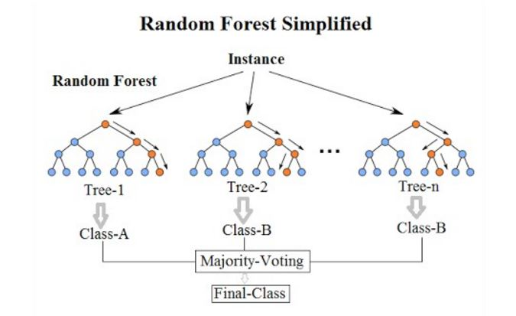

Slide 21
2.LOGISTIC REGRESSION
A classification algorithm that is used to assign observations to a discrete set of classes.
Logistic regression transforms its output using the logistic sigmoid function to return a probability value.
Produces results in a binary format
3.MULTINOMIAL NB
It is a specialized version of Naive Bayes that is designed
for text documents.
Simple naive Bayes would model a document as the
presence and absence of particular words
Multinomial naive bayes explicitly models the word counts and adjusts the underlying calculations to deal with in.

Slide 22
4.LSTM
Long short-term memory (LSTM) is an artificial recurrent neural network (RNN) architecture
used in the field of deep learning.
LSTM networks are well-suited to classifying,
processing and making predictions based on
time series data, since there can be lags of
unknown duration between important events in
a time series

Slide 23
CHALLENGES FACED
First Challenge, was to list down, and research the forms, and types of sentiment analysis, and different ways, in which it can be done.
Another challenge was about the data. We did some research, about twitter, and usual behaviour of people, on twitter, and how they communicate. We then took the data from the standard Kaggle data repository and found the data very useful.
The steps, of sentiment analysis, are many and varied. To keep a check on the quality, we pre-processed the data, so that the accuracy comes out to be good.
To apply Deep Neural Network on the tweets, was another big and major step in the pipeline.To study and research about twitter API, and new features of twitter API, and to be able to use them.

Slide 24
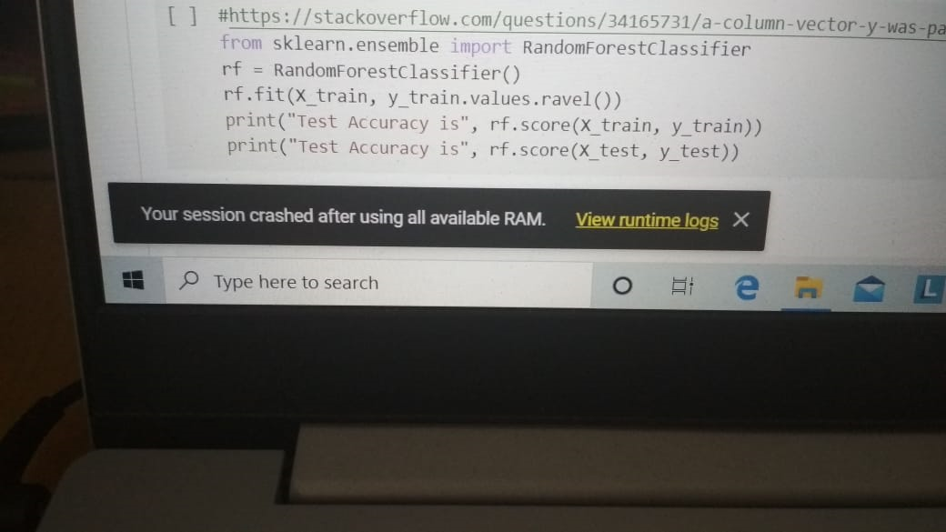
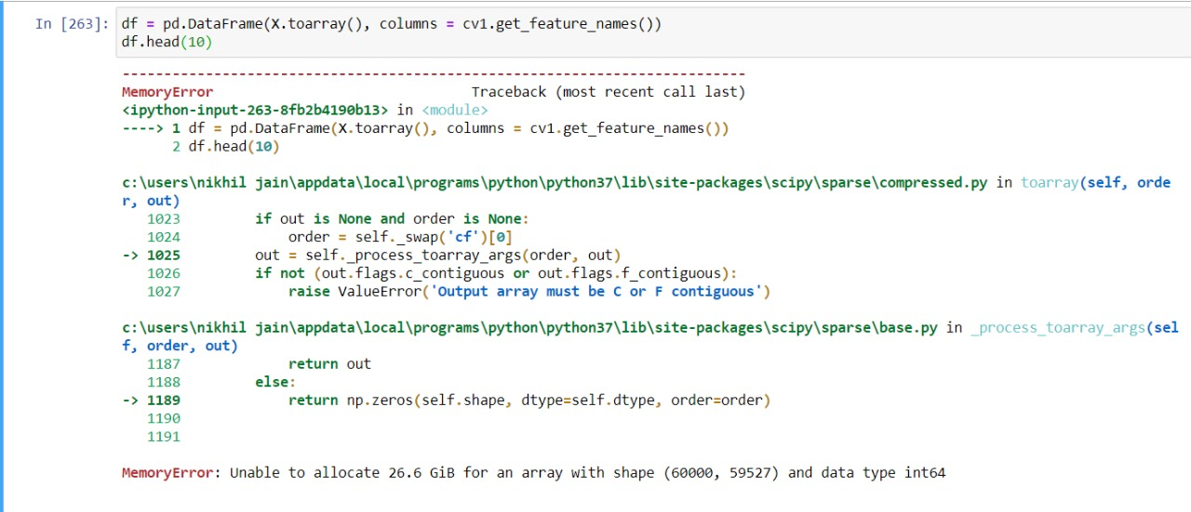
The biggest challenge amongst all was that the system disk space was running overtime and crashing.

Slide 25
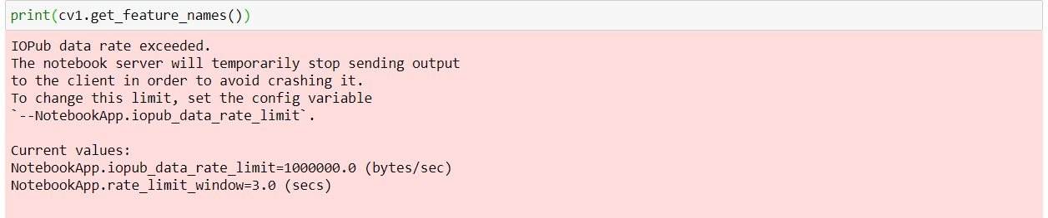
As a result we tried on google collaboratory.
But in google colaboratory also RAM was crashing again and again

Slide 26
FUTURE SCOPE
The applications of high end sentiment analysis, are huge. It can be used, anywhere, and everywhere.
Some applications include - Company review, and share holders, and public's sentiment about the company, and to see the effect on stock prices, and other decisions in the company.
Future scope, of this project could also, be in determining the fake news, for Eg. Fake News about Covid-19.
To determine, public sentiments, for government decision, which is very important now-a-days. For Eg. To check, if people want the Covid-19 pandemic Lockdown to be removed or not, and in which area.
Certainly, this requires, much more computational power, and data collection resources, and can be done, on a medium scale, if data is collected

Slide 27
REFERENCES
[1] K. N. Alhayyan et al."Discovering and Analyzing Important Real-Time Trends in Noisy Twitter Stream" n.p
[2] J. Ramteke et al ., \Election result prediction using Twitter sentiment analysis," in Inventive Computation Technologies (ICICT), International Conference on, 2016, vol. 1, pp. 1-5.
[3] M. Desai et al., "Techniques for sentiment analysis of Twitter data: A comprehensive survey", 2016 International Conference on Computing, Communication and Automation (ICCCA), 2016.
[4] A. Pak et a., "Twitter as a corpus for sentiment analysis and opinion mining". In Proceedings of the Seventh International Conference on Language Resources and Evaluation (LREC'10), may 2010.

